Slide 1
Neonatal sepsis Dr.A.VASUNDHARA, Professor& HOD Pediatrics.

Slide 2
Neonatal infections are estimated to cause about 1.6 million deaths worldwide and 40% of all neonatal deaths due to sepsis occur in developing countries.
Even though neonatal care has dramatically improved over the last decade, the overall as well as gestation specific mortality due to sepsis has not changed much due to more and more smaller babies surviving in the intensive care units.

Slide 3
DEFINITION
Systemic bacterial infections of the newborn are termed as neonatal sepsis and include overwhelming infection without localization (Septicemia), or pneumonia, meningitis, urinary tract infection.

Slide 4
CLASSIFICATION
1.Early onset sepsis
2. Late onset sepsis

Slide 5
NEONATAL INFECTION BY AGE OF ONSET
Characteristics | Early onset sepsis | Late onset sepsis
Age at onset | Birth to 72 hrs of life | > 72 hrs of life
Maternal obstetric complications | Common | Uncommon
Prematurity | Frequent | Varies
Manifestation | Multisystem | Multisystem / focal

Slide 6
EARLY ONSET SEPSIS
Predisposing factors
• Low birth weight.
• Prolonged rupture of membranes >24hrs.
• Chorioamnionitis (Foul smelling amniotic fluid, Maternal fever >37.90C).

Slide 7
Multiple per vaginal examination
Etiologic agents – organisms prevalent in maternal genital area. E.coli, Group B streptococci.

Slide 8
LATE ONSET SEPSIS
Predisposing factors
• Prolonged NICU stay.
• Disruption of skin integrity with needle pricks and use of IV fluids.
• Frequent use of broad spectrum antibiotics.

Slide 9
LATE ONSET SEPSIS
Etiologic agents – organisms thriving in external environments of home or hospital.
Transmitted through hands of care‐providers. Klebsiella pneumoniae, CONS, MRSA

Slide 10
CLINICAL MANIFESTATIONS
May have either nonspecific signs and symptoms (e.g. not doing well, not accepting feeds) or focal signs of infection involving one system (abdominal distension) or it may be acute catastrophic deterioration with multi‐organ dysfunction.
Various criteria have been devised to identify sepsis which are shown in the next slide

Slide 11
CLINICAL CRITERIA FOR DIAGNOSIS OF SEPSIS
 | IMNCI | WHO
Not able to feed | + | +( not able sustain such)
Not attaching to breast | + | -
Not sucking at all | + | -
Pus draining from ear | + | -

Slide 12
CLINICAL CRITERIA FOR DIAGNOSIS OF SEPSIS
Redness around umbilicus extending to the skin | + | -
Reduced movements | + | +( change in activity)
Lethargy or unconsciousness | + | +(not aroused by minimal stimulus)
Convulsions | + | +
Bulging fontanel | + | -

Slide 13
 | IMNCI | WHO
Respiratory rate >60/min | + | +(divided by age group)
Severe chest indrawing | + | +
Nasal flaring | + | _
Grunting | + | _

Slide 14
 | IMNCI | WHO
Crepitations | _ | +
Cyanosis | _ | +
Temperature >37.70c ( feels hot) or <35.5c(feels cool) | + +: Means Presence | +

Slide 15
DIAGNOSIS
Gold standard remains isolation of organism from body fluids ( blood or urine or CSF).
In cases of suspected sepsis following sepsis screen should be done and antibiotics should be started immediately after collecting blood culture sample.

Slide 16
DIFFERENTIAL DIAGNOSIS
Hypothermia.
Hypoglycemia.
Metabolic encephalopathy.

Slide 17
INVESTIGATIONS
Haemogram
I/T ratio
Micro ESR
CRP
Blood culture‐ 1ml blood in 10ml broth
Chest X‐ray
Blood sugar

Slide 18
INVESTIGATIONS (CONT..)
Positive sepsis screen ‐ 2 or more positive tests as given below.
TLC ( < 5,000 or > 20,000/cu.mm),
Neutropenia‐ Absolute neutrophil count (<1800/cu.mm)
Immature neutrophil (band cells) to total neutrophil (I/T) ratio > 0.2
C‐reactive proteins‐ positive
Micro ESR‐ (ESR > 15mm at 1st hr.)

Slide 19
TREATMENT – SUPPORTIVE CARE
Provide warmth, ensure consistently normal
temperature
Provide bag and mask ventilation with oxygen if
breathing is inadequate
Start oxygen by hood or mask, if cyanosed or grunting
Provide gentle physical stimulation, if apneic.
Start intravenous line
Infuse glucose (10%)2ml/kg stat (if hypoglycemic)

Slide 20
TREATMENT – SUPPORTIVE CARE
If perfusion is poor as evidenced by capillary refill
time (CRT) of more than 3 seconds, manage shock.
Inj. Vitamin K 1mg IM
Consider use of dopamine if perfusion is persistently poor.
Avoid enteral feed if very sick, give maintenance
fluid intravenously.

Slide 21
ANTI‐MICROBIALS
Antibiotic therapy for sepsis
Antibiotic Each dose Frequency Route
mg/kg/dose <7days >7 days
Ampicillin 50 12 hrly 8 hrly IV
Gentamycin 5 24hrly 24hrly IV

Slide 22
ANTI‐MICROBIALS (CONT..)
Antibiotic Each dose Frequency Route
mg/kg/dose <7days >7 days
Cefotaxim 50 12 hrly 8 hrly IV
Gentamycin 5 24hrly 24hrly IV

Slide 23
DURATION OF ANTIBIOTICS
If not improving in 2‐3 days the antibiotic treatment may need to be changed , preferably as per microbial culture reports.
Blood culture negative sepsis‐7 to 10 days
Blood culture positive sepsis‐10 to 14 days
Meningitis ‐21days.

Slide 24
RECENT ADVANCES
IVIG
Colony stimulating factor
Exchange transfusion
All these modalities need further studies.

Slide 25
NEONATAL SEPSIS (CONT..)
Superficial infections
Conjunctivitis
Pustules
Umbilical sepsis
Mastitis Neonatorum
Oral thrush

Slide 26
MASTITIS NEONATORUM
Term baby, both sexes
Engorgement of breast due to effect of transplacentally
transferred progesterone and estrogens.
This hypertrophy disappears spontaneously but local
massage and fomentation and temptation to express milk leads to abscess formation.
Treatment with parenteral antibiotics and surgical
drainage.

Slide 27
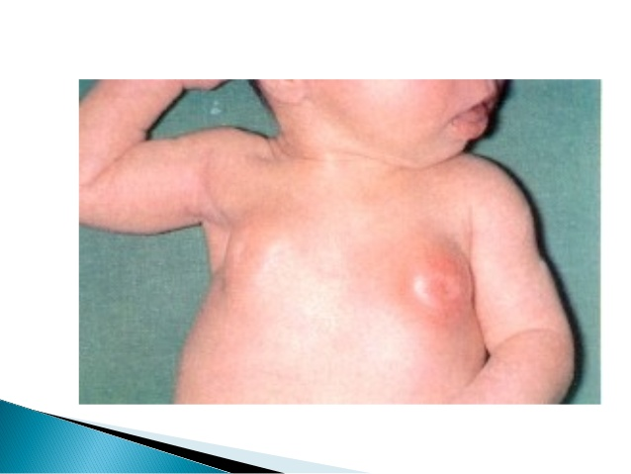
CLINICAL IMAGE: MASTITIS NEONATORUM

Slide 28
PUSTULES
Seen over scalp, neck, axillae and groin.
Caused by staphylococci.
Can be punctured with sterile needle and clean with spirit / betadine.
Treatment with local application of antibiotics.
If increasing in size and number then oral antibiotics e.g. cloxacillin

Slide 29
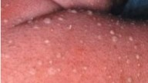
CLINICAL IMAGE: PUSTULES

Slide 30
ORAL THRUSH
Caused by Candida albicans.
White patches with erythematous margins distributed
over the tongue and buccal mucosa.
Unlike milk curds, patches of thrush are adherent and
they often bleed when attempts are made to remove.
Treatment – local application of gentian violet or
nystatin or clotriamazole after each feed.
Screen mother for mammary candidiasis and treat it

Slide 31
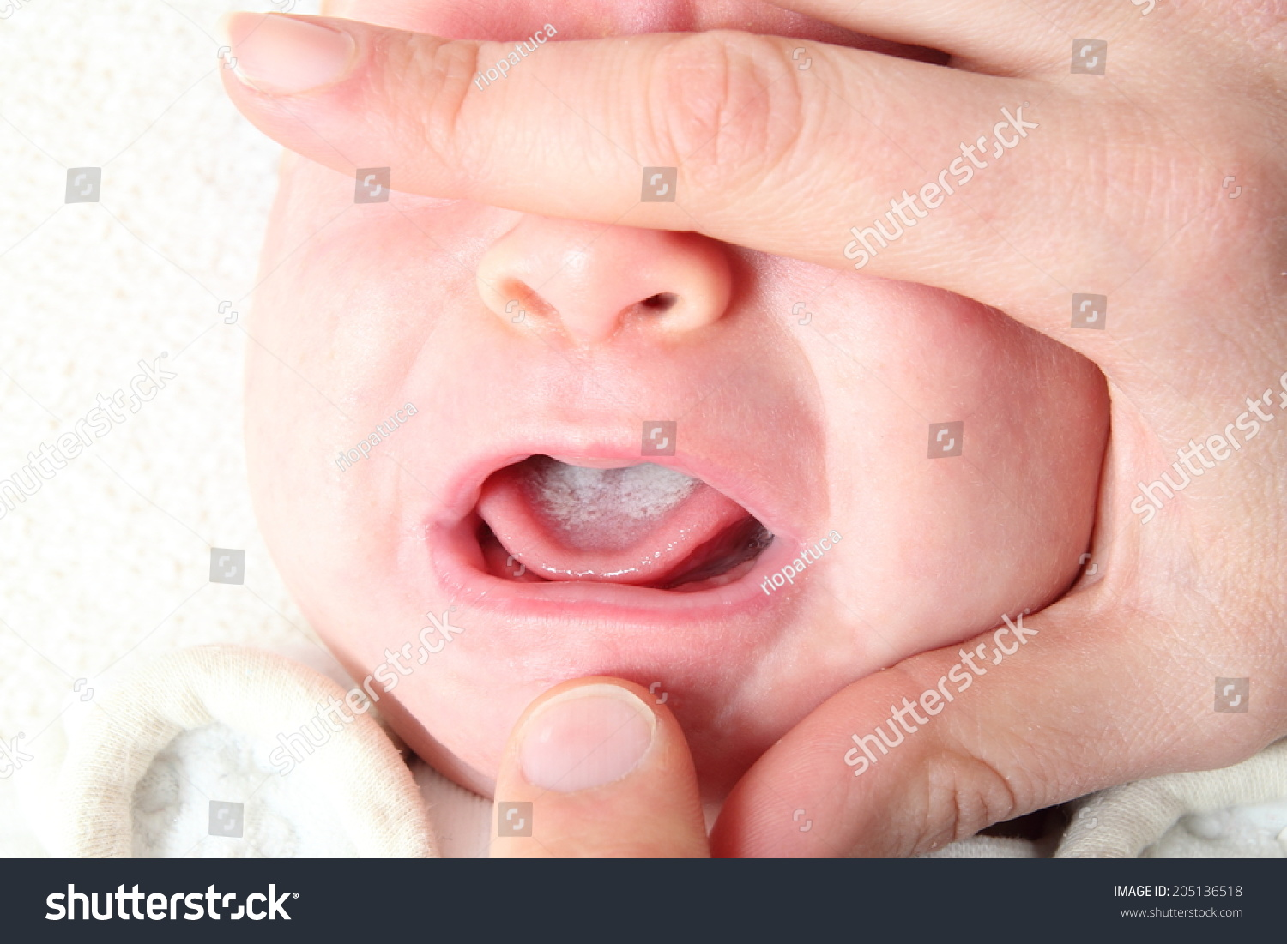
CLINICAL IMAGE: ORAL THRUSH

Slide 32
UMBILICAL SEPSIS
Caused by usual skin flora i.e. staphylococci.
Redness and edema at the base of the cord and a foul
smelling purulent discharge.
Presence of mucoid discharge on the stump and even isolation of bacteria are not indicative of umbilical sepsis unless there is clinical evidence of periumbilical
inflammation or there are pus cells in the exudate.
Treat with local application of antibiotics.
With evidence of systemic spread‐ parenteral antibiotics.

Slide 33
CONJUNCTIVITIS
Gonococcal conjunctivitis less commonly seen .
Usually caused by organisms present in maternal
flora or chlamydia.
Purulent conjunctivitis can be treated with
Neosporin or chloramphenicol ophthalmic drops,
Eye cleaning with water, Nasolacrimal duct massage.

Slide 34
PREVENTION
Good antenatal, intranatal and postnatal care
Clean attendant’s hand ( washed with soap)
Clean delivery surface
Clean cord cutting instrument (i.e. razor, blade)
Clean string to tie cords
Clean cloth to wrap the baby
Clean cloth to wrap the mother

Slide 35
PREVENTION (CONT..)
Prevent overcrowding
Ensure early breastfeeding
Hand washing.

Slide 36
PREVENTION – HAND WASH
Before touching any baby ‐
Sleeves should be rolled above the elbows. Rings,
watches and jewellery should be removed.
1st hand wash‐ up to elbows with a thorough scrub for
2 minutes, all areas including the under surface of well
trimmed nails.
In between patients hand wash for 20 seconds up to
elbows.

Slide 37
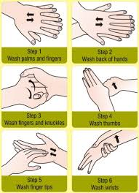
HAND WASHING IN 6 STEPS

Slide 38
SUMMARY
Commonest cause of neonatal mortality
High index of suspicion
Early diagnosis
Prompt treatment.

